Slide 1
Aqua Permit Simulations:
Foster, Tiner, and
Waterson 1 and 2
Draft Report: June 2, 2023
Supplemental Information: November 8 and November 11, 2023
William R. Hutchison, Ph.D., P.E., P.G.
November 15, 2023

Slide 2
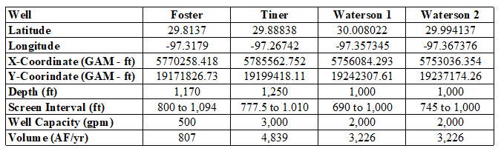
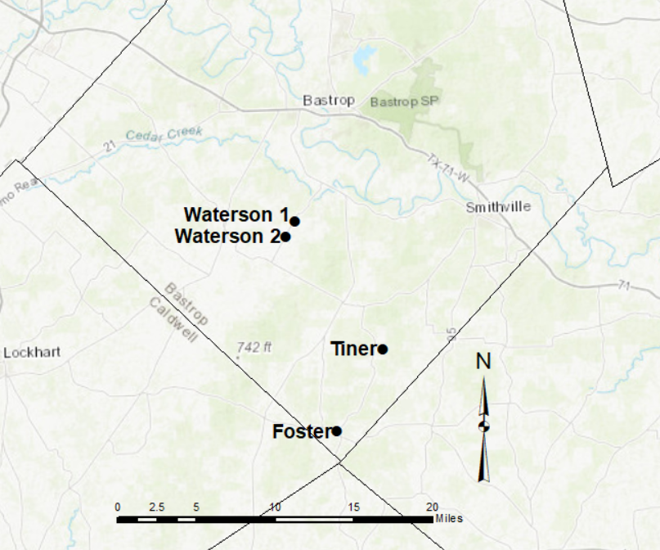
Summary Well Data

Slide 3
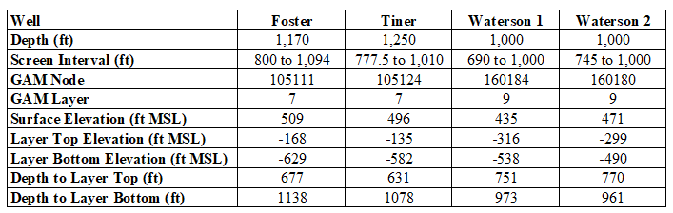
Aquifer Completion Data

Slide 4
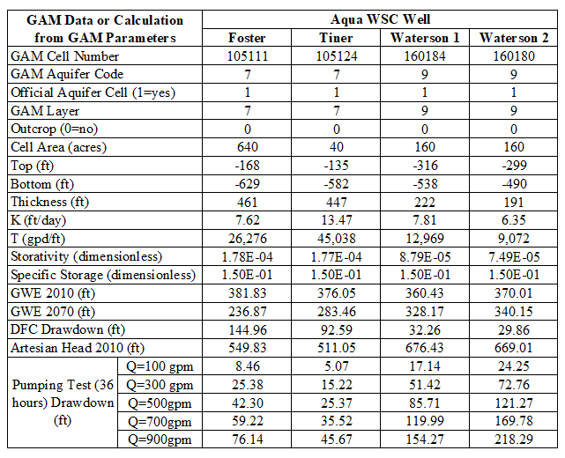
Aquifer Completion Data

Slide 5
Simulation Summary (Foster)
Proposed pumping volume = 807 AF/yr
Drawdown from 2011 to 2070 at Foster Well location = 18 ft
Significant sources of the proposed pumping:
  Captured outflow that would have gone to Caldwell and Fayette counties.
  Vertical inflow from the overlying Reklaw formation
  Storage reduction in the Carrizo Aquifer.

Slide 6
Simulation Summary (Tiner)
Proposed pumping volume = 4,839 AF/yr
Drawdown from 2011 to 2070 at Tiner Well location = 102 ft
Significant sources of the proposed pumping:
  Induced inflow from the shallow flow system.
  Induced vertical inflow from the overlying Reklaw formation.
  Storage reduction in the Carrizo Aquifer.
  Captured outflow components from Fayette County
  Captured vertical outflow to the underlying Calvert Bluff Aquifer
  Storage decline in the Carrizo Aquifer.

Slide 7
Simulation Summary (Waterson 1)
Proposed pumping volume = 3,226 AF/yr
Drawdown from 2011 to 2070 at Waterson 1 well location = 119 ft
Significant sources of the proposed pumping:
  Over half of the proposed pumping would be sourced as induced inflow from the shallow flow system.
  Induced inflow from the overlying Carrizo Aquifer.
  Storage decline supplies less than ten percent of the increased pumping.

Slide 8
Simulation Summary (Waterson 2)
Proposed pumping volume = 3,226 AF/yr
Drawdown from 2011 to 2070 at Waterson 2 well location = 163 ft
Significant sources of the proposed pumping:
  Over half of the proposed pumping would be sourced as induced inflow from the shallow flow system.
  Induced inflow from the overlying Carrizo Aquifer.
  Storage decline supplies less than ten percent of the increased pumping

Slide 9
Attributable Drawdown Hydrographs
Foster
Tiner
Waterson 1
Waterson 2

Slide 10
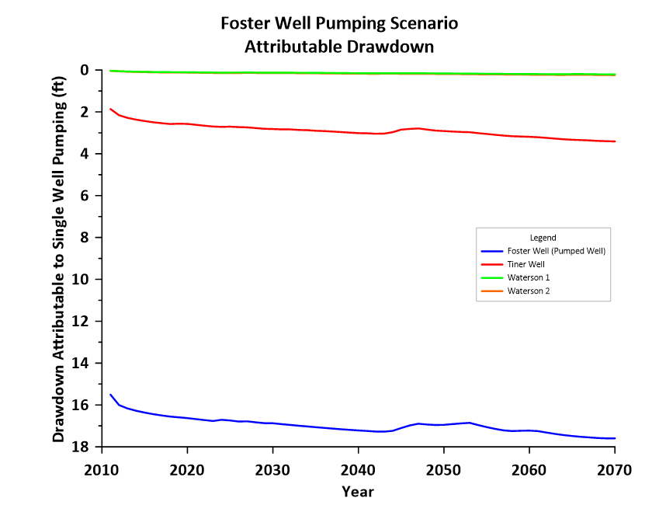
Attributable Drawdown (Foster)

Slide 11
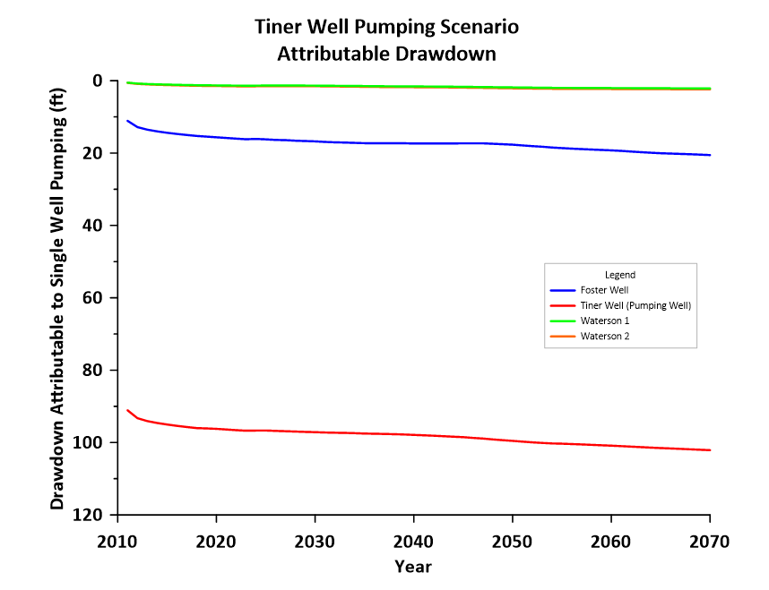
Attributable Drawdown (Tiner)

Slide 12
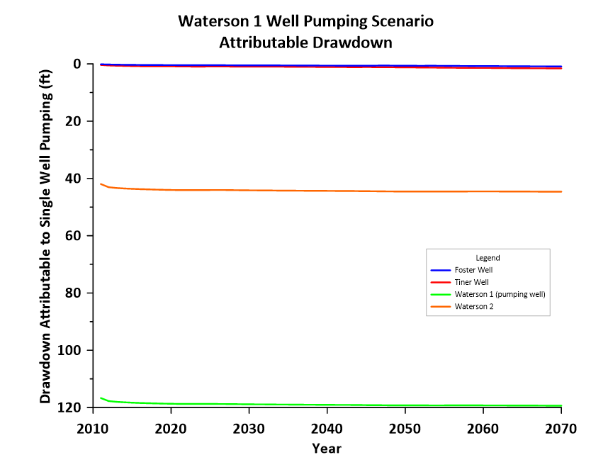
Attributable Drawdown (Waterson 1)

Slide 13
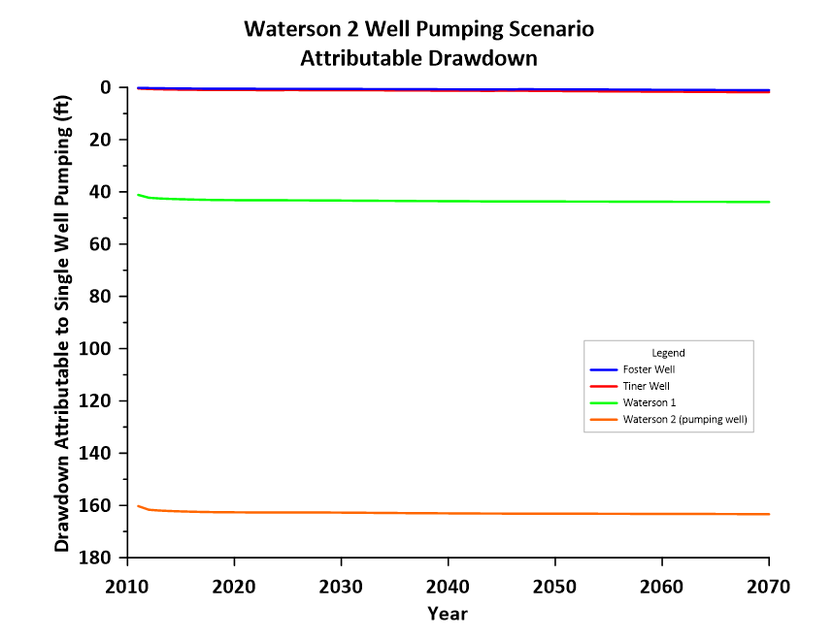
Attributable Drawdown (Waterson 2)

Slide 14
Groundwater Budget Results
Foster
Tiner
Waterson 1
Waterson 2

Slide 15
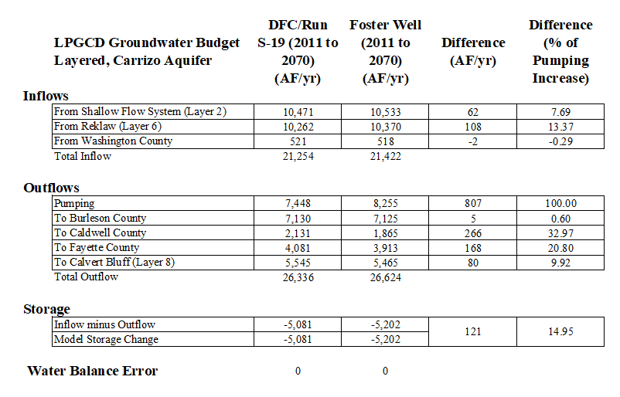
Groundwater Budget (Foster)

Slide 16
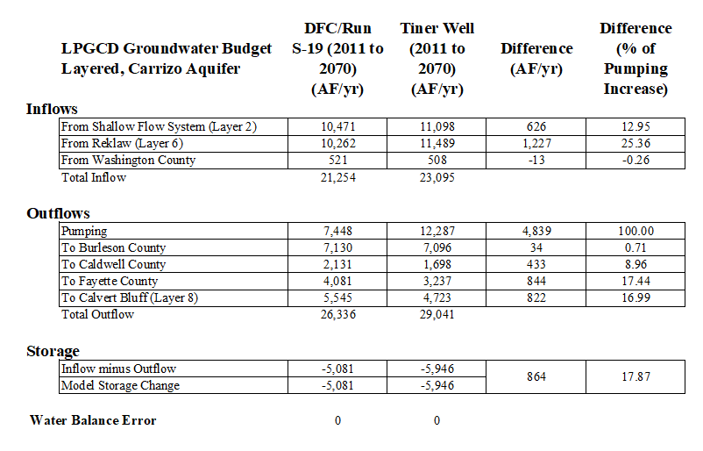
Groundwater Budget (Tiner)

Slide 17
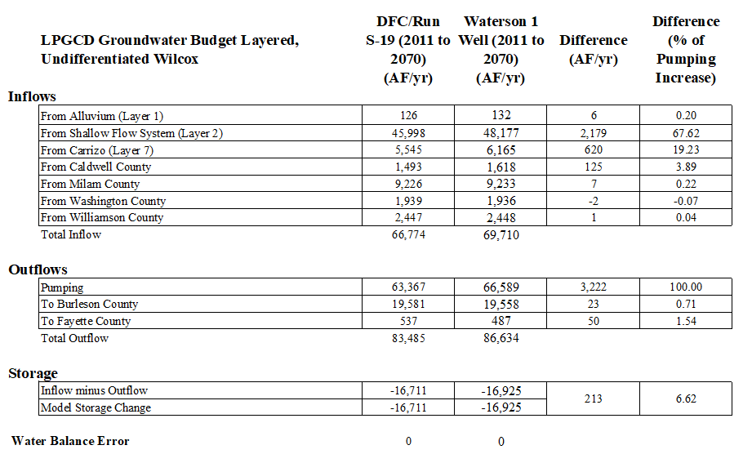
Groundwater Budget (Waterson 1)

Slide 18

Groundwater Budget (Waterson 2)

Slide 19
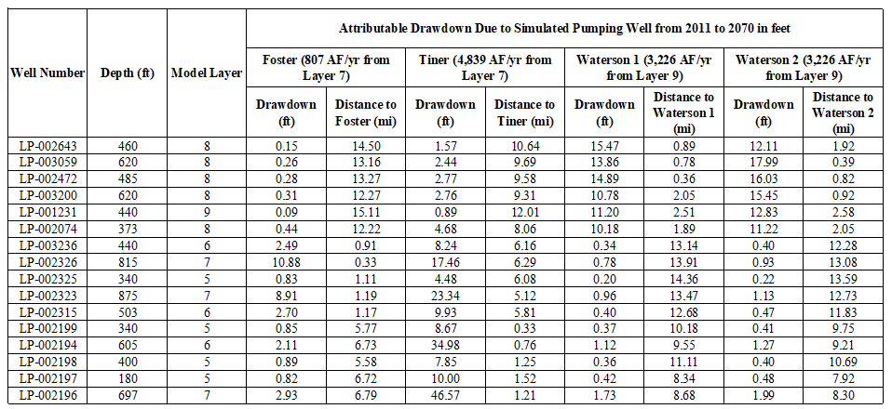
Analysis of Nearby Wells

Slide 20
Distance-Drawdown Graphs
Foster
Tiner
Waterson 1
Waterson 2

Slide 21
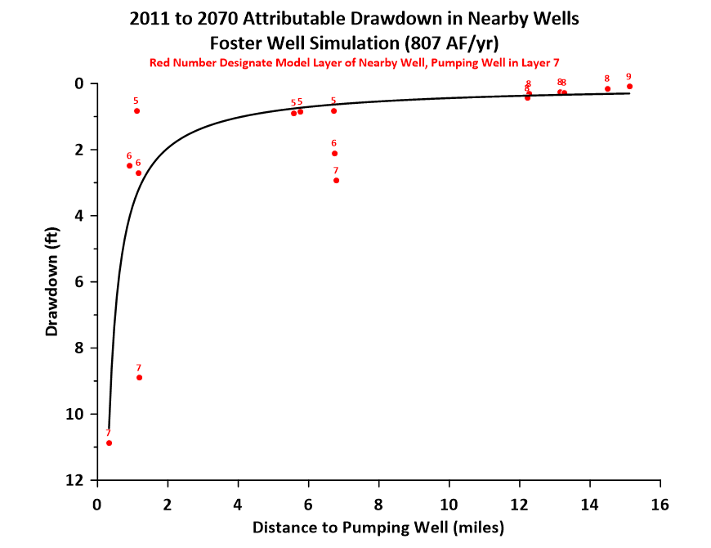

Slide 22
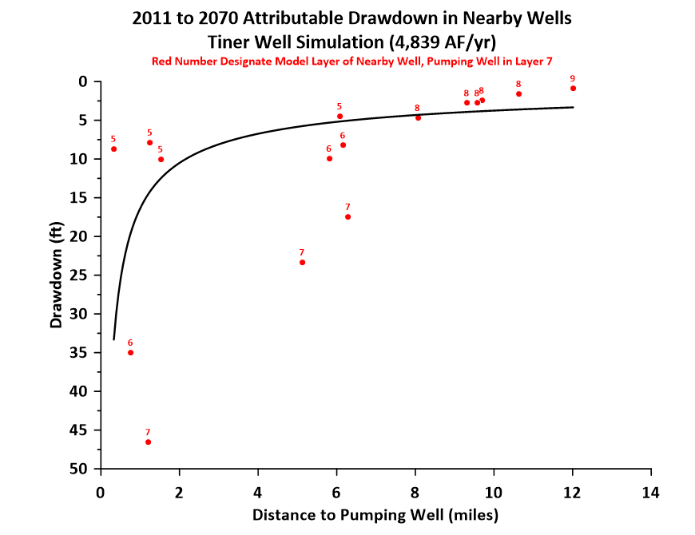

Slide 23
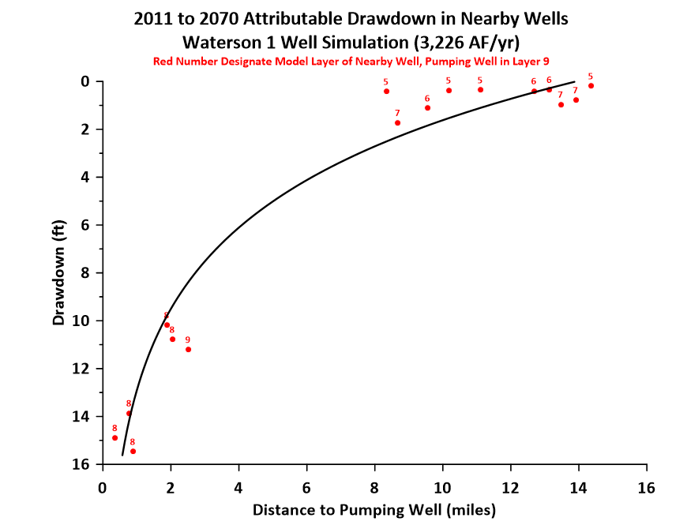

Slide 24
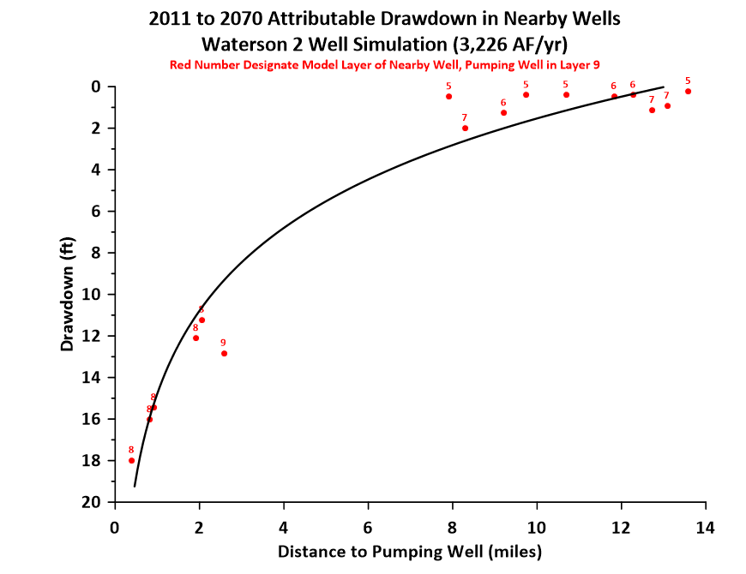

Slide 25
Attributable Drawdown Contours
Foster
  Layer 7
Tiner
  Layer 7
  Layer 6
  Layer 8
  Layer 2
Waterson 1
  Layer 9
  Layer 8
  Layer 10
  Layer 2
Waterson 2
  Layer 9

Slide 26
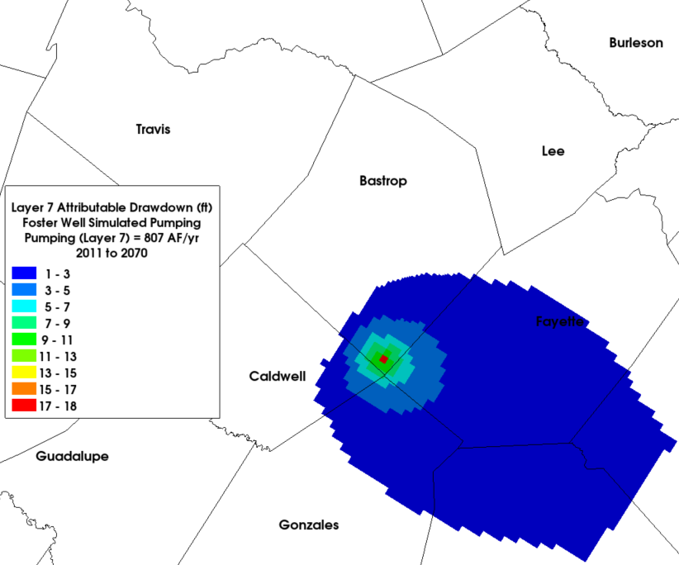
Foster – Layer 7

Slide 27
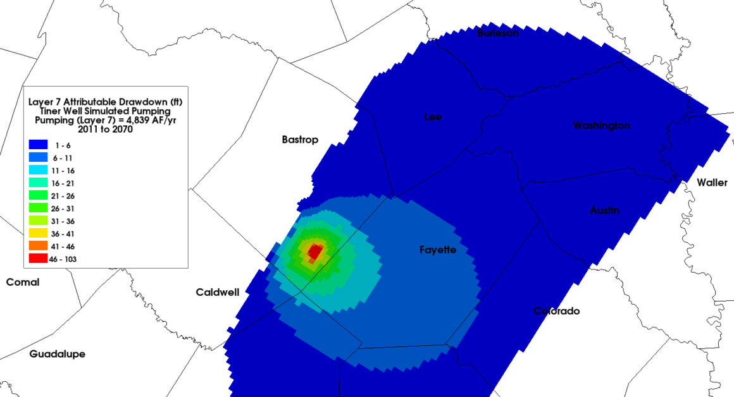
Tiner – Layer 7

Slide 28
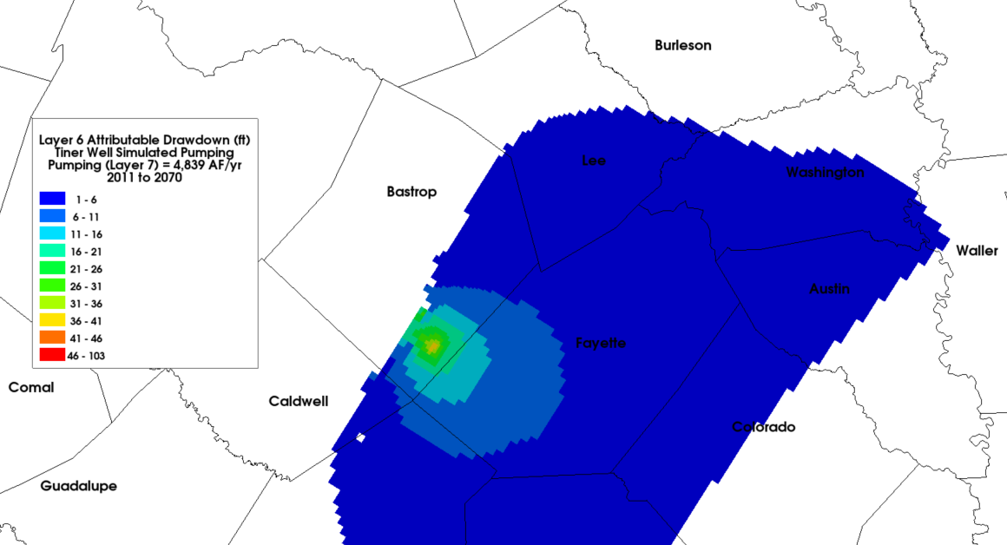
Tiner – Layer 6

Slide 29
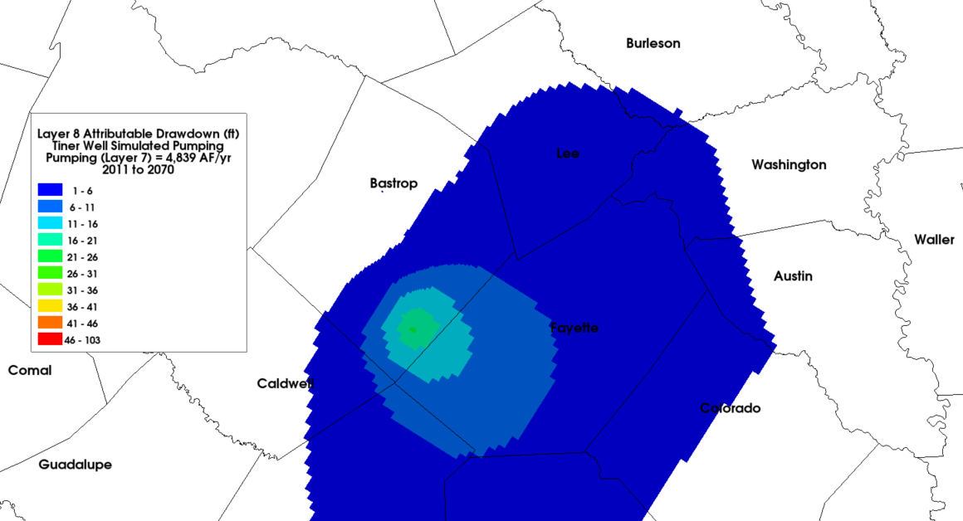
Tiner – Layer 8

Slide 30
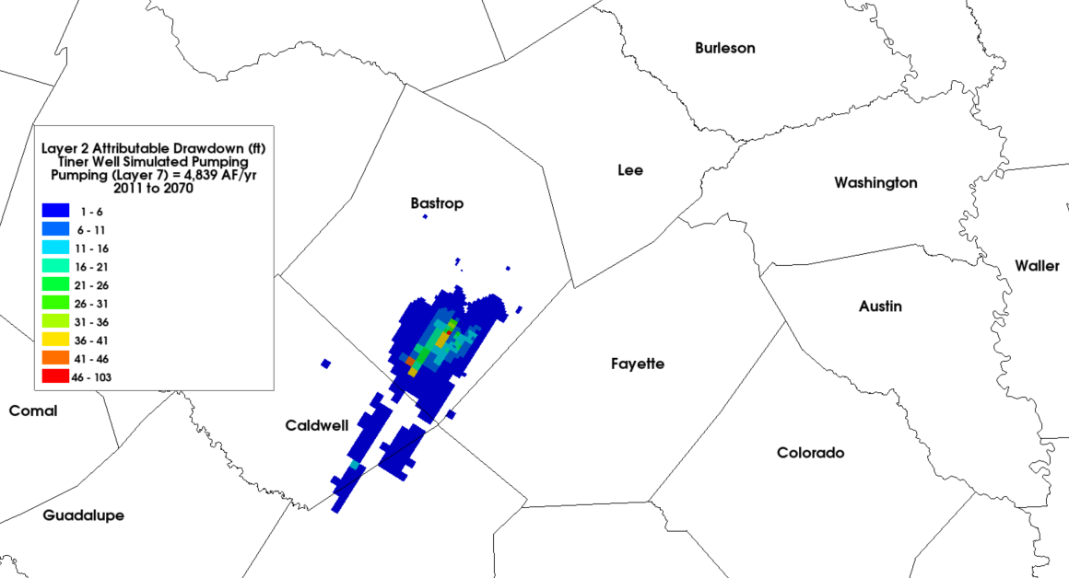
Tiner – Layer 2

Slide 31
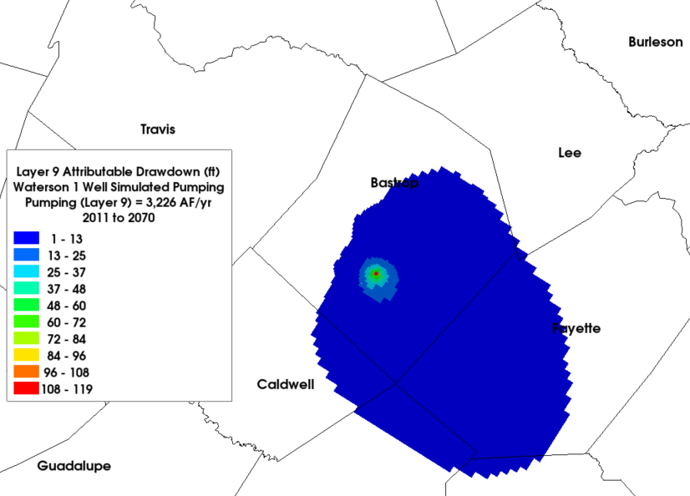
Waterson 1 – Layer 9

Slide 32
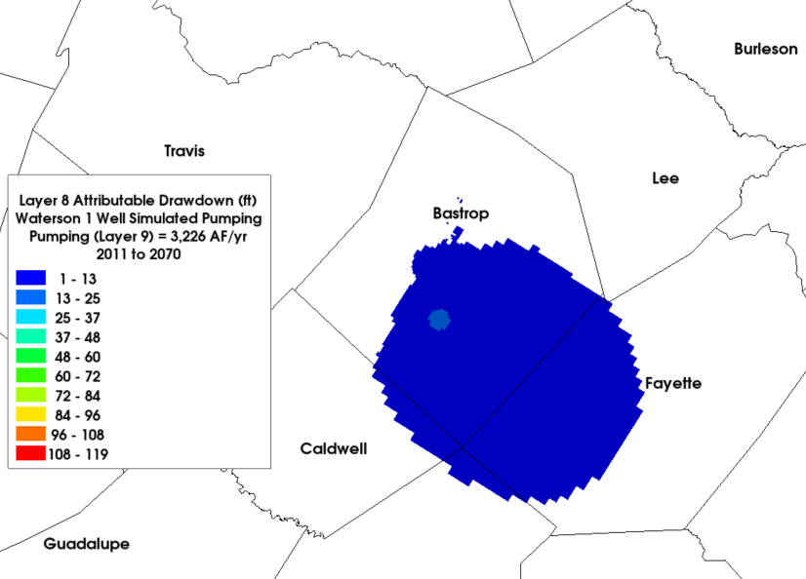
Waterson 1 – Layer 8

Slide 33
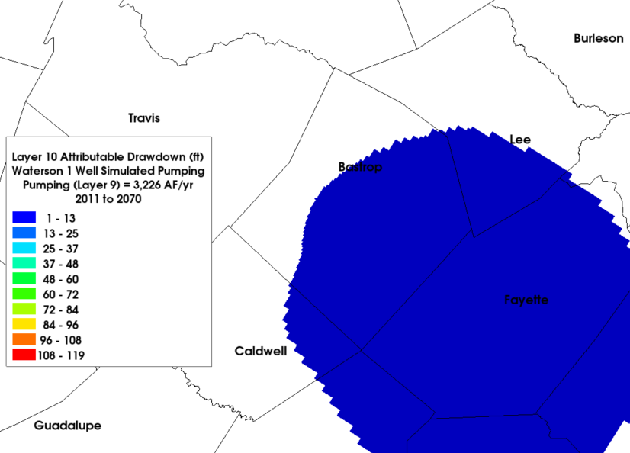
Waterson 1 – Layer 10

Slide 34
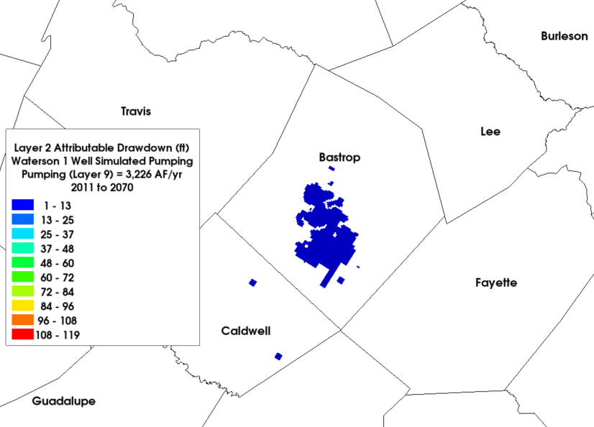
Waterson 1 – Layer 2

Slide 35
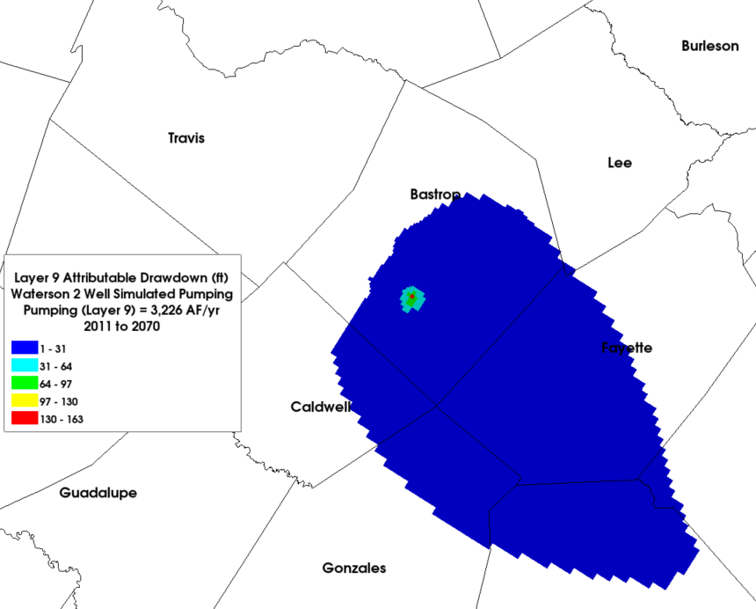
Waterson 2 – Layer 9

