Slide 1
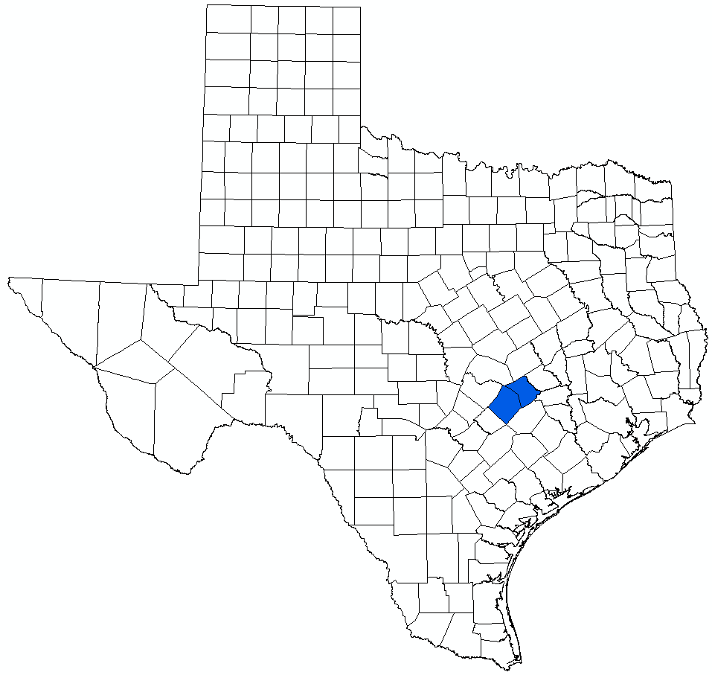
Thomas Turfgrass Permit Application:
GAM Simulations
Bill Hutchison, Ph.D., P.E., P.G.
LPGCD Board Meeting
July 19, 2023

Slide 2
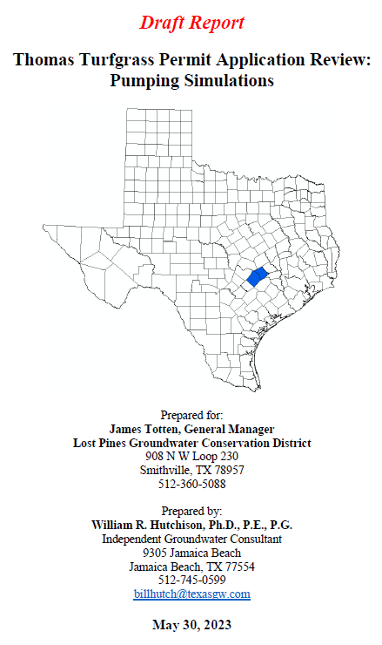
Report Outline
Introduction
  Summary of Results and Conclusions
Summary of Well Locations and Aquifer Completions
  Proposed Production Wells
  Nearby Registered Wells
Analysis of Irrigation Water Needs
Annual Pumping Simulations
DFC Condition Simulations

Slide 3
Summary of Results and Conclusions (1)
Two sets GAM simulations completed
  Historical climatic conditions (1954 to 2010)
  DFC Conditions (2011 to 2080)
Permit application requested 3,950 AF/yr
  Drought conditions
Average irrigation needs range between 1,800 and 2,200 AF/yr
  Needs analysis demonstrated that 3,950 AF/yr is reasonable for drought conditions
Need to develop a compliance standard
  Annual pumping will vary depending on climatic conditions

Slide 4
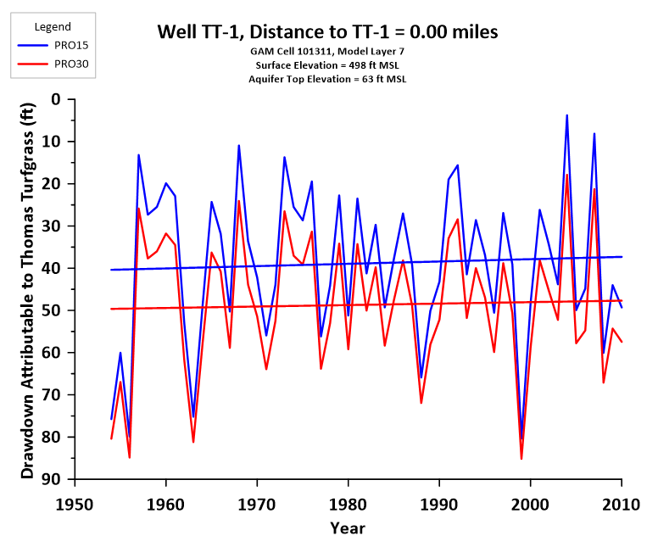
Summary of Results and Conclusions (2)
In the “irrigated area”:
  Drawdown of between 40 and 50 feet
  New dynamic equilibrium (sustainable pumping rate)

Slide 5
Summary of Results and Conclusions (3)
Source of pumped water will be from “shallow flow system”
  Could have impacts on shallow wells in Carrizo outcrop area and to surface water-groundwater interactions
  Monitoring of the outcrop area is recommended
Another significant source of the proposed pumping is vertical inflow from overlying and underlying formations
  Monitoring of the overlying and underlying formations in the immediate area is recommended

Slide 6
Questions and Discussion
Bill Hutchison, Ph.D., P.E., P.G.
billhutch@texasgw.com
512-745-0599

Slide 7
Details
Well Locations and Depths
Production Rate and Irrigation Needs Analysis
Annual Simulations (1954 to 2010)
DFC Simulations (2011 to 2080)

Slide 8
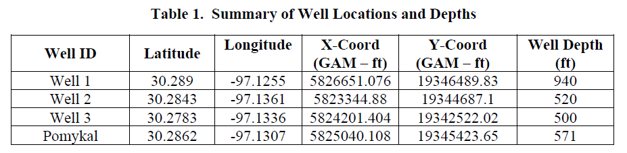

Slide 9
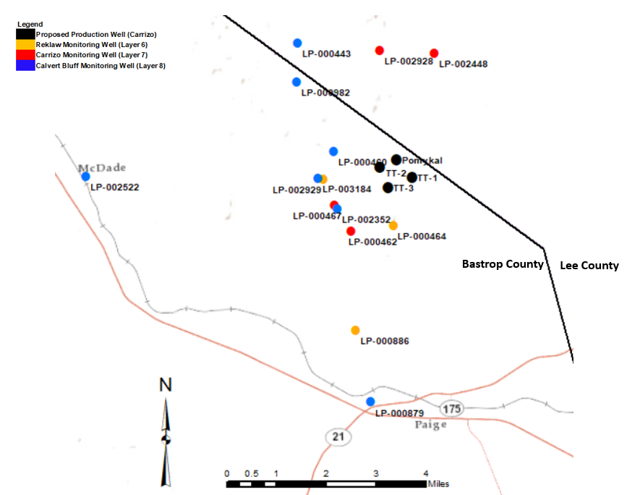
Well Locations (Report Fig. 1)

Slide 10
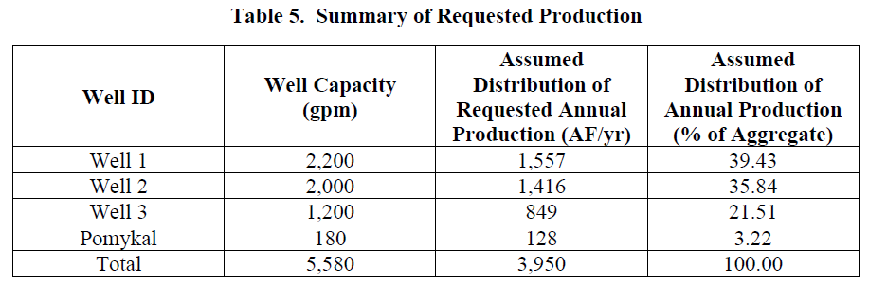

Slide 11
Requested Production
3,950 AF/yr
  “… the amount estimated to be needed based on turfgrass irrigation needs assuming little to no rainfall (drought conditions)”
Duty for 970 acres:
  48.87 in/yr
  4.07 ft/yr
Represents the maximum pumping
Simulations require estimates of pumping in all years

Slide 12
Basic Equation to Calculate Water Needs
Water Needs = ET (annual) - [Rainfall - Runoff]
ET and Rainfall data from TWDB (Average of Quads 710 and 711)
Runoff estimates from Texas Cooperative Extension webpage on turfgrass
  Range is 15% to 30%

Slide 13
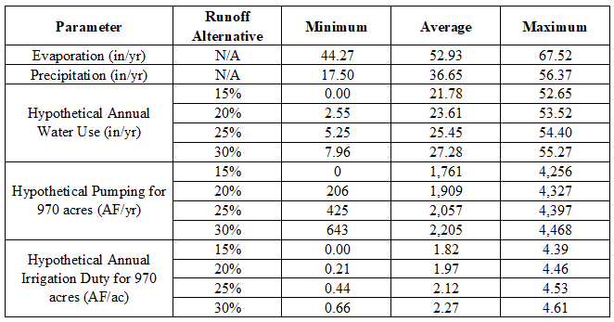
Hypothetical Annual Water Use and Duties from 1954 to 2022
(Table 6 of Report)

Slide 14
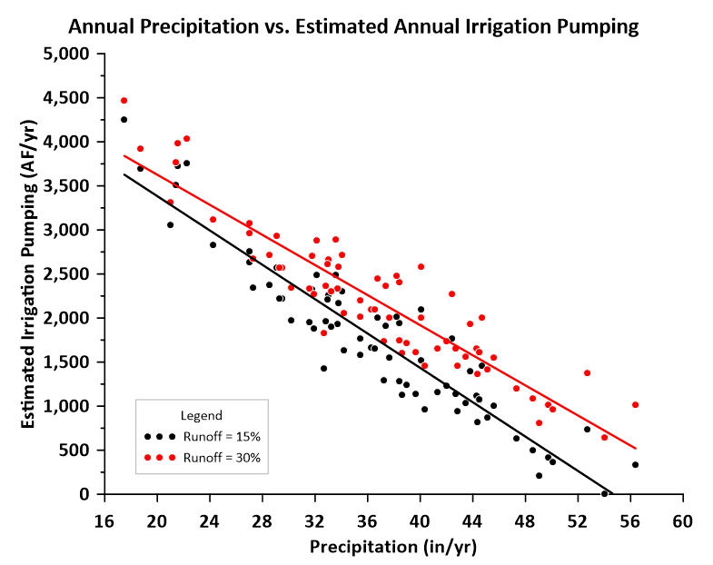

Slide 15
Annual Simulations
Assumed two scenarios:
  15% runoff
  30% runoff
Assumed 1954 to 2010 precipitation and evaporation
  Calculated irrigation pumping based on irrigation needs analysis
  Distributed pumping based on production capacity
Results
  Hydrographs
    Four Thomas Turfgrass wells
    14 “monitoring wells”
  Groundwater budget
    Quantified source of pumping (Carrizo only and Lumped Reklaw, Carrizo, Calvert Bluff)

Slide 17
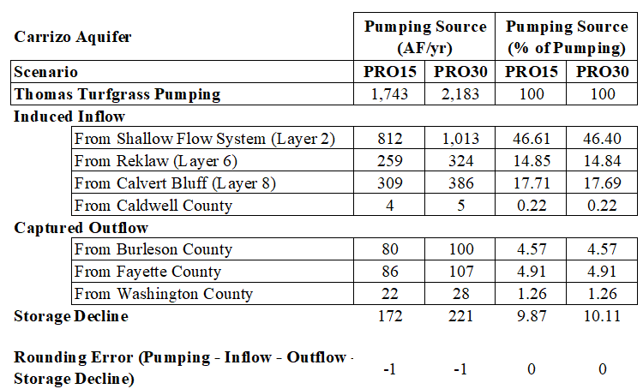
Carrizo Groundwater Budget

Slide 18
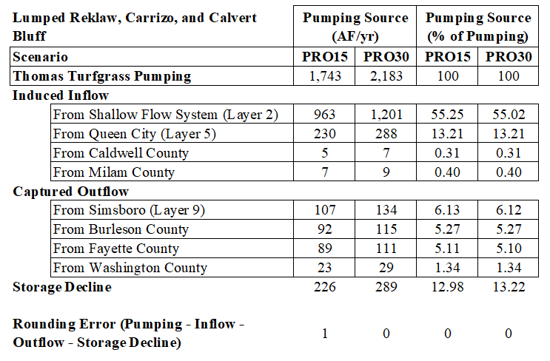
Reklaw, Carrizo, Calvert Bluff Groundwater Budget

Slide 19
DFC Simulations
Assumed three scenarios:
  Average pumping under 15% runoff assumption
  Average pumping under 30% runoff assumption
  Maximum pumping
Added pumping to DFC simulation (2011 to 2080)
  Distribution based on production capacity
Results
  Hydrographs
    Four Thomas Turfgrass wells
    14 “monitoring wells”
  Groundwater budget
    Quantified source of pumping (Carrizo only and Lumped Reklaw, Carrizo, Calvert Bluff)

Slide 20
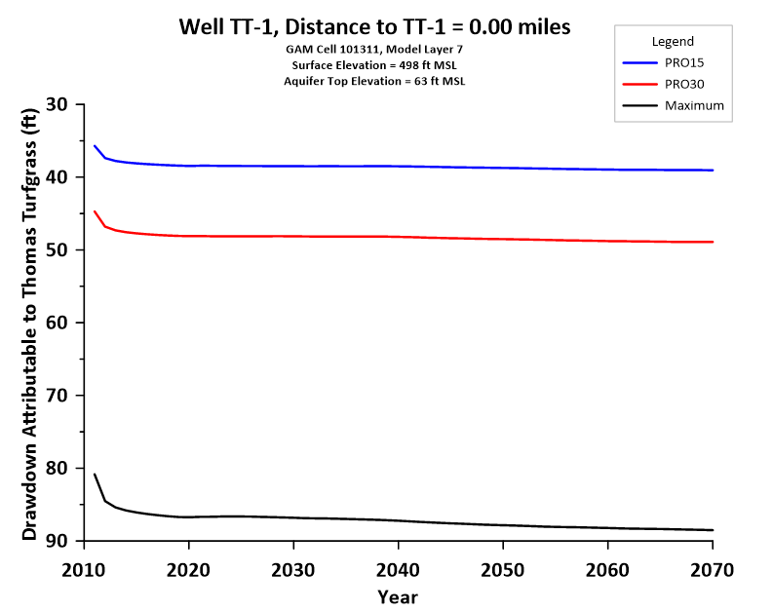

Slide 21
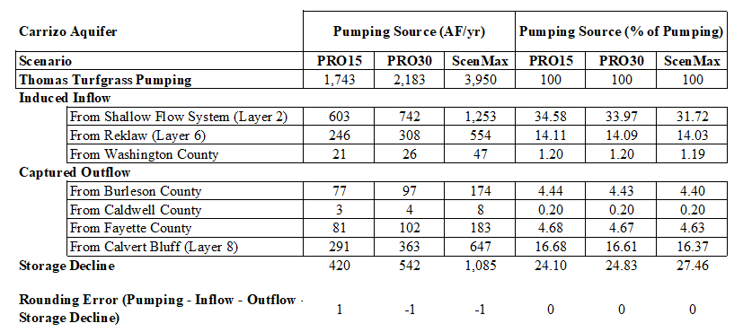
Carrizo Groundwater Budget

Slide 22
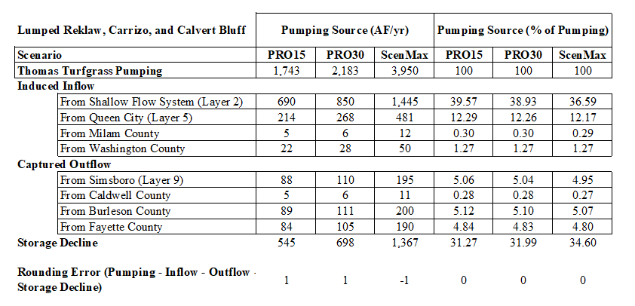
Reklaw, Carrizo, Calvert Bluff Groundwater Budget

